Slide 1
M12

Slide 2
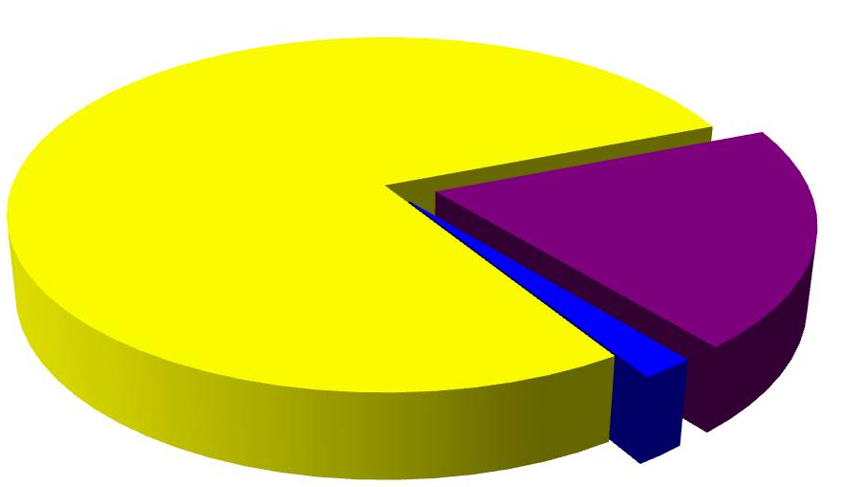
The oxygen cycle
Oxygen is a very abundant element on our Earth.
21% oxygen
It is found in the elemental form in the atmosphere to the extent of 21%.

Slide 3

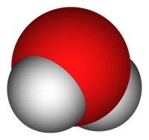

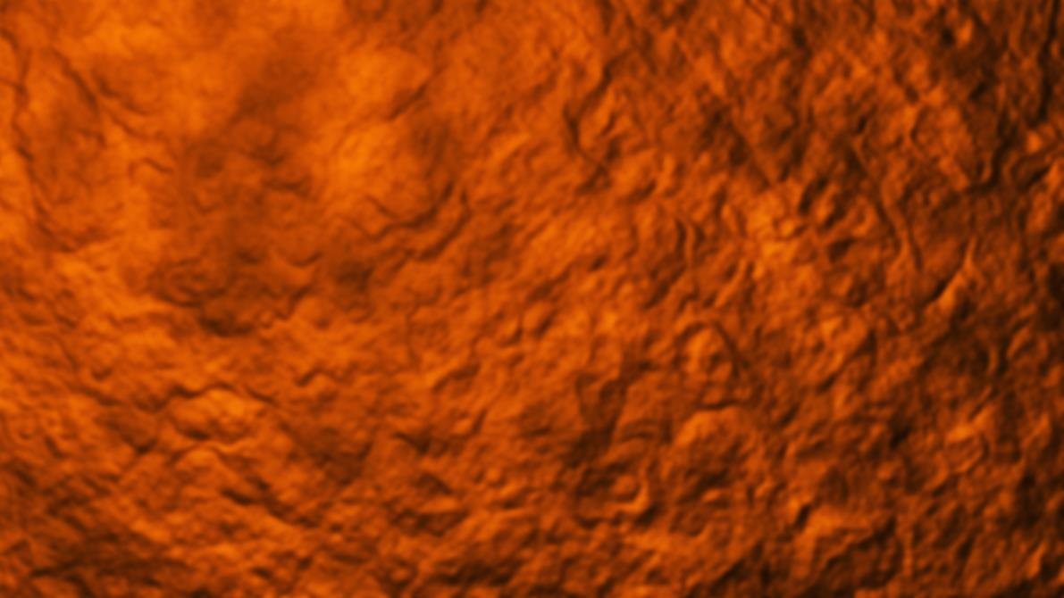
It also occurs extensively in the combined form in the Earth’s crust as well as also in the air in the form of carbon dioxide.
C
o
o
In the crust, it is found as the oxides of most metals and silicon, and also as carbonate, sulphate, nitrate and other minerals.
C
CO₃
C
SO₄
NO₃
o
o
o
o

Slide 4
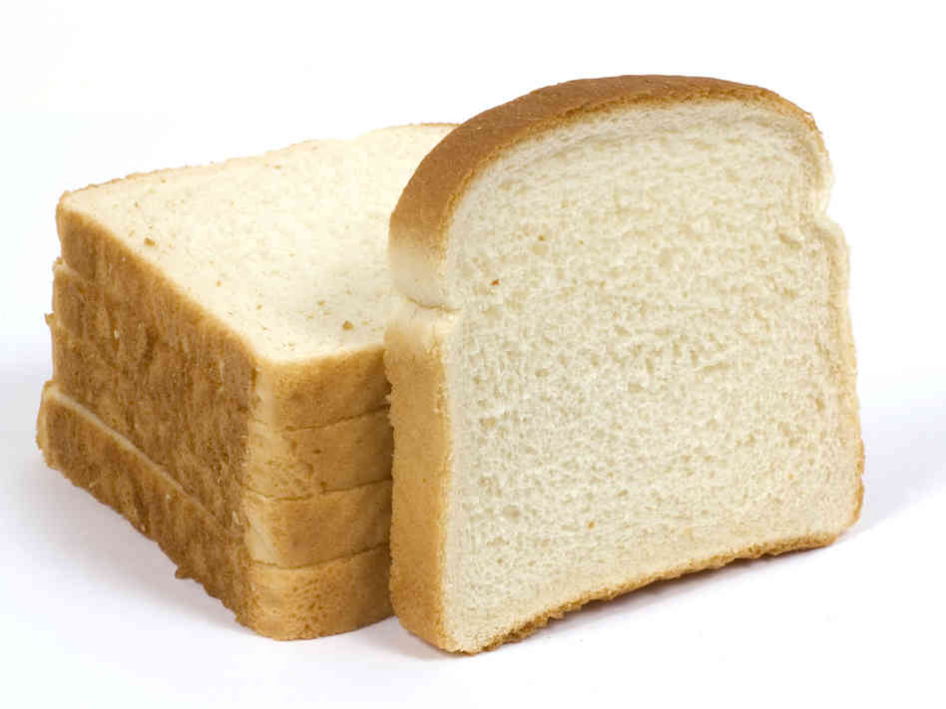
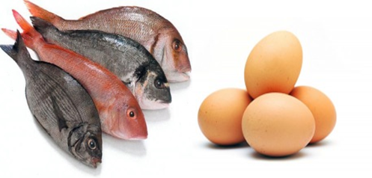
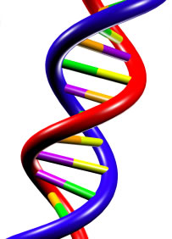
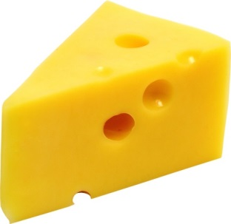
The oxygen cycle
It is also an essential component of most biological molecules like carbohydrates, proteins nucleic acids and fats (or lipids).
Carbohydrates
Proteins
Nucleic acids
Fats
DNA and RNA

Slide 5
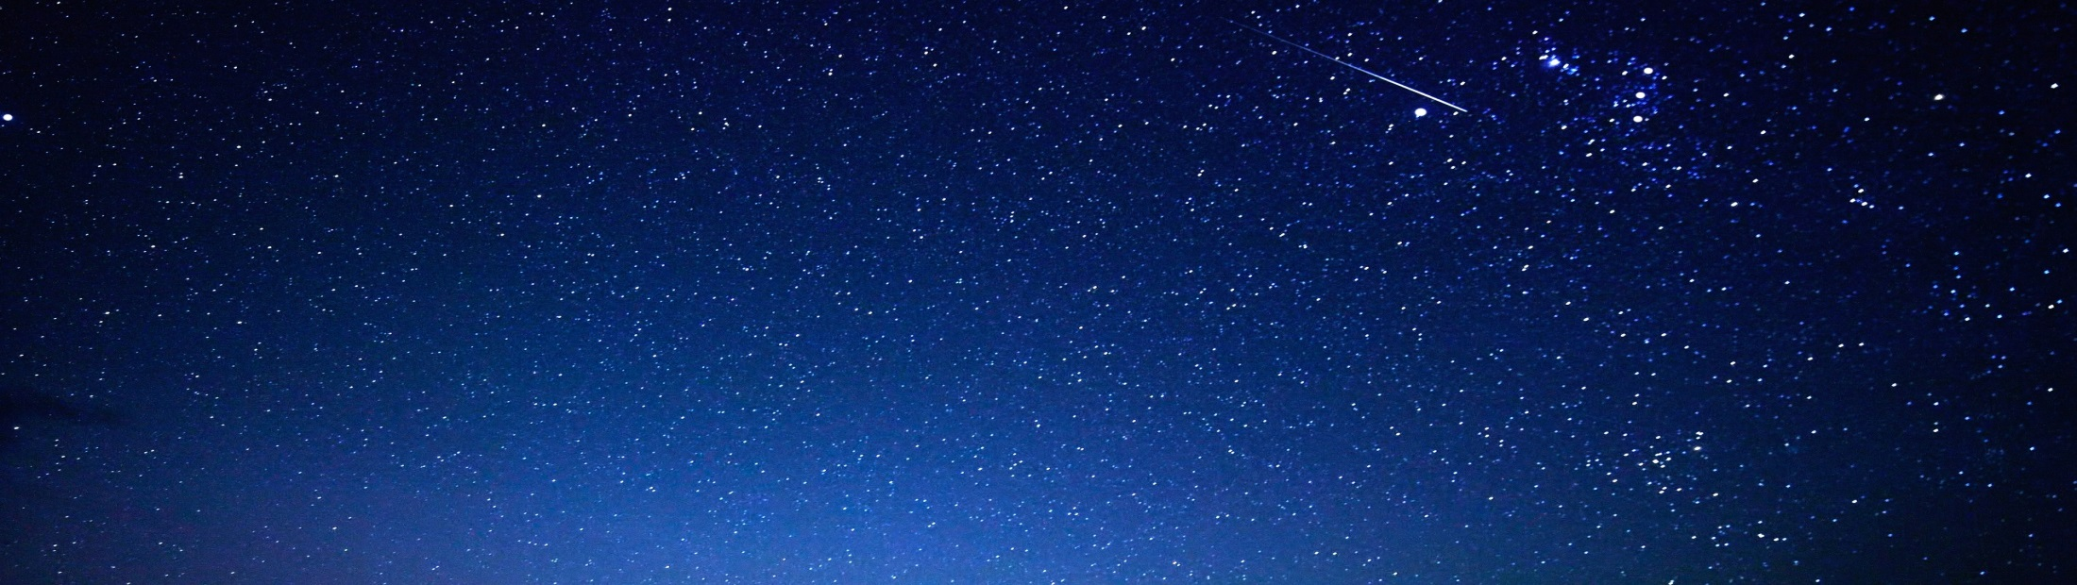
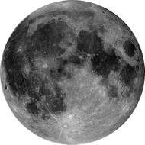

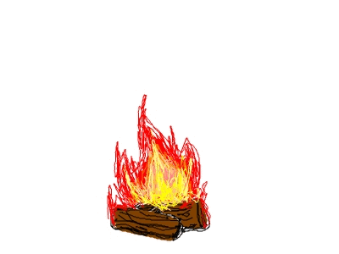
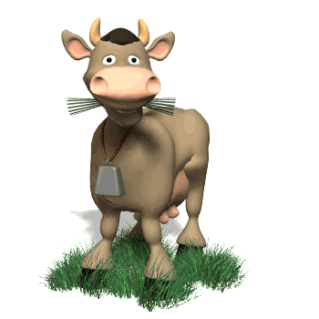

O₂
N₂
NO₂
O₂
Oxygen from the atmosphere is used up in three processes, namely
O₂
O₂
respiration,
combustion
and in the formation of oxides of nitrogen.
Respiration
Combustion

Slide 6
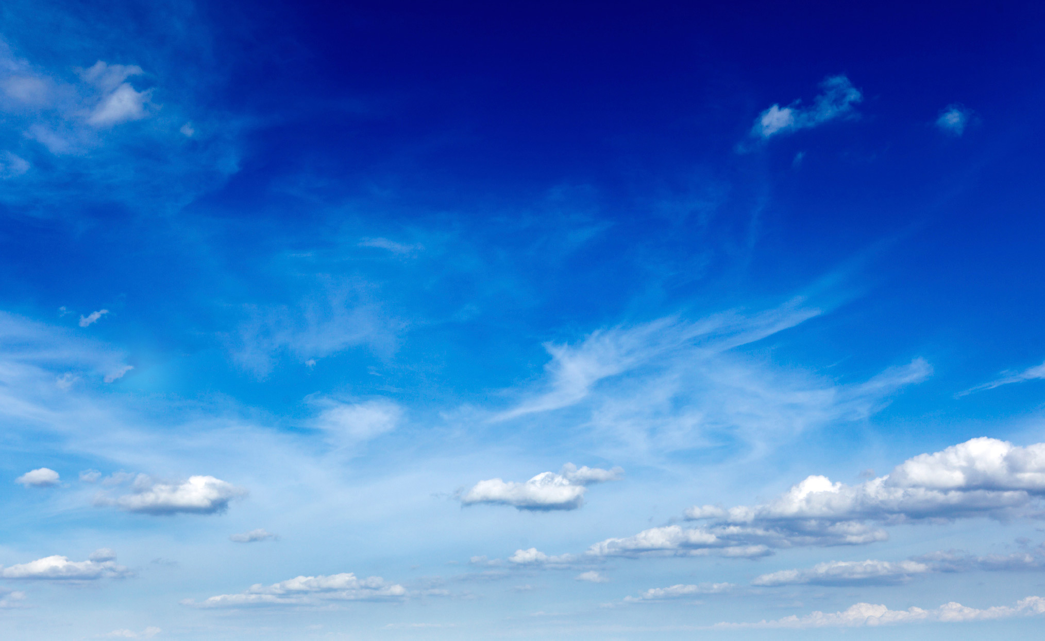
SUN
Photosynthesis
O₂
Oxygen is returned to the atmosphere in only one major process, that is, photosynthesis.
O₂
O₂
O₂
Respiration
Combustion

